Slide 1
Sentiment analysis
CS616

Slide 2
Scherer Typology of Affective States
Emotion: brief organically synchronized … evaluation of a major event
angry, sad, joyful, fearful, ashamed, proud, elated
Mood: diffuse non-caused low-intensity long-duration change in subjective feeling
cheerful, gloomy, irritable, listless, depressed, buoyant
Interpersonal stances: affective stance toward another person in a specific interaction
friendly, flirtatious, distant, cold, warm, supportive, contemptuous
Attitudes: enduring, affectively colored beliefs, dispositions towards objects or persons
liking, loving, hating, valuing, desiring
Personality traits: stable personality dispositions and typical behavior tendencies
nervous, anxious, reckless, morose, hostile, jealous
* Recommended reading: Pan (2008) Opinion mining and sentiment analysis. (pdf on course webpage)
* Jurofsky’s NLP lecture slides

Slide 3
Sentiment Analysis
Sentiment analysis is the detection of attitudes
“enduring, affectively colored beliefs, dispositions towards objects or persons”
Holder (source) of attitude
Target (aspect) of attitude
Type of attitude
From a set of types
Like, love, hate, value, desire, etc.
Or (more commonly) simple weighted polarity:
positive, negative, neutral, together with strength
Text containing the attitude
Sentence or entire document

Slide 4
Sentiment Analysis
Simplest task:
Is the attitude of this text positive or negative?
More complex:
Rank the attitude of this text from 1 to 5
Advanced:
Detect the target, source, or complex attitude types

Slide 5


Positive or negative movie review?
unbelievably disappointing
Full of zany characters and richly applied satire, and some great plot twists
this is the greatest screwball comedy ever filmed
It was pathetic. The worst part about it was the boxing scenes.

Slide 6
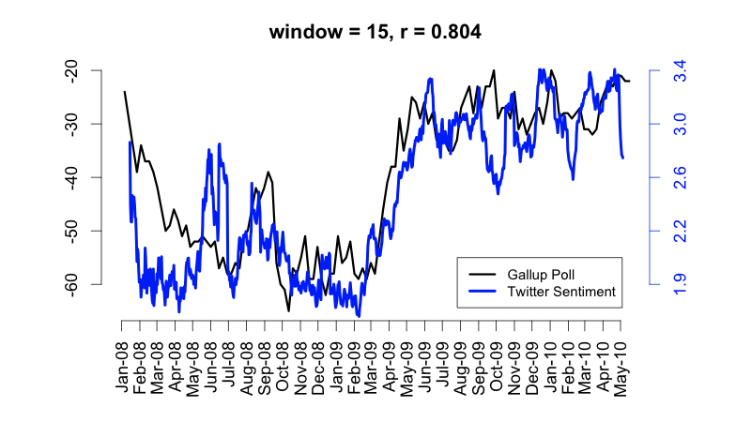
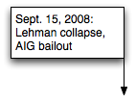
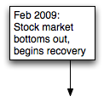
Twitter sentiment versus Gallup Poll of Consumer Confidence
Notes:
Thanks to Brendan O’Connor and Noah Smith (email, 1/18/12) for permission to use this figure.

Slide 7
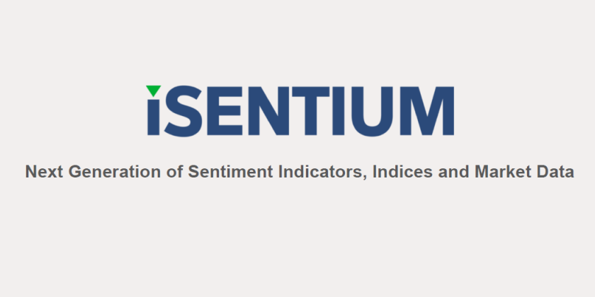
Lots of interest from finance

Slide 8
Sentiment Classification in Movie Reviews
Bo Pang, Lillian Lee, and Shivakumar Vaithyanathan. 2002. Thumbs up? Sentiment Classification using Machine Learning Techniques. EMNLP-2002, 79—86.
Bo Pang and Lillian Lee. 2004. A Sentimental Education: Sentiment Analysis Using Subjectivity Summarization Based on Minimum Cuts. ACL, 271-278
Polarity detection:
Is an IMDB movie review positive or negative?
Data: Polarity Data 2.0:
http://www.cs.cornell.edu/people/pabo/movie-review-data

Slide 9
IMDB data in the Pang and Lee database
✓
✗
when _star wars_ came out some twenty years ago , the image of traveling throughout the stars has become a commonplace image . […]
when han solo goes light speed , the stars change to bright lines , going towards the viewer in lines that converge at an invisible point .
cool .
_october sky_ offers a much simpler image–that of a single white dot , traveling horizontally across the night sky . [. . . ]
“ snake eyes ” is the most aggravating kind of movie : the kind that shows so much potential then becomes unbelievably disappointing .
it’s not just because this is a brian depalma film , and since he’s a great director and one who’s films are always greeted with at least some fanfare .
and it’s not even because this was a film starring nicolas cage and since he gives a brauvara performance , this film is hardly worth his talents .

Slide 10
Baseline Algorithm (adapted from Pang and Lee)
Tokenization
Feature Extraction
Classification using different classifiers
Naïve Bayes
SVM

Slide 11
Sentiment Tokenization Issues
Deal with HTML and XML markup
Twitter mark-up (names, hash tags)
Capitalization (preserve for
words in all caps)
Phone numbers, dates
Emoticons
Useful code:
Christopher Potts sentiment tokenizer
Brendan O’Connor twitter tokenizer
Potts emoticons
[<>]? # optional hat/brow
[:;=8] # eyes
[\-o\*\']? # optional nose
[\)\]\(\[dDpP/\:\}\{@\|\\] # mouth
| #### reverse orientation
[\)\]\(\[dDpP/\:\}\{@\|\\] # mouth
[\-o\*\']? # optional nose
[:;=8] # eyes
[<>]? # optional hat/brow

Slide 12
Extracting Features for Sentiment Classification
How to handle negation
I didn’t like this movie
vs
I really like this movie
Which words to use?
Only adjectives
All words
All words turns out to work better, at least on this data

Slide 13
Negation
Das, Sanjiv and Mike Chen. 2001. Yahoo! for Amazon: Extracting market sentiment from stock message boards. In Proceedings of the Asia Pacific Finance Association Annual Conference (APFA).
Bo Pang, Lillian Lee, and Shivakumar Vaithyanathan. 2002. Thumbs up? Sentiment Classification using Machine Learning Techniques. EMNLP-2002, 79—86.
Add NOT_ to every word between negation and following punctuation:
didn’t like this movie , but I
didn’t NOT_like NOT_this NOT_movie but I

Slide 14
Naïve Bayes

Slide 15
Boolean Multinomial Naïve Bayes: Learning
From training corpus, extract Vocabulary
Eliminate all duplicate words in each document
Calculate P(c_{j}) terms
For each c_{j} in C do
docs_{j} ← all docs with class =c_{j}
Calculate P(w_{k} | c_{j}) terms
Text_{j} ← single doc containing all docs_{j}
For each word w_{k} in Vocabulary
n_{k} ← # of occurrences of w_{k} in Text_{j}

Slide 16
Boolean Multinomial Naïve Bayes on a test document d
First remove all duplicate words from d
Then compute NB using the same equation:

Slide 17
Binarized (Boolean feature) Multinomial Naïve Bayes
Binary seems to work better than full word counts
Other possibility: log(freq(w))

Slide 18
Problems: Sarcasm
Subtlety:
Perfume review in Perfumes: the Guide:
“If you are reading this because it is your darling fragrance, please wear it at home exclusively, and tape the windows shut.”
Dorothy Parker on Katherine Hepburn
“She runs the gamut of emotions from A to B”

Slide 19
Problems: Ordering
“This film should be brilliant. It sounds like a great plot, the actors are first grade, and the supporting cast is good as well, and Stallone is attempting to deliver a good performance. However, it can’t hold up.”
Well as usual Keanu Reeves is nothing special, but surprisingly, the very talented Laurence Fishbourne is not so good either, I was surprised.

Slide 20
Typical fix: bigger dictionaries
Called sentiment lexicons in the trade
List of most commonly associated words and phrases for positive or negative sentiment
Obtained by manual annotation followed by machine learning

Slide 21
The General Inquirer
Home page: http://www.wjh.harvard.edu/~inquirer
List of Categories: http://www.wjh.harvard.edu/~inquirer/homecat.htm
Spreadsheet: http://www.wjh.harvard.edu/~inquirer/inquirerbasic.xls
Categories:
Positiv (1915 words) and Negativ (2291 words)
Strong vs Weak, Active vs Passive, Overstated versus Understated
Pleasure, Pain, Virtue, Vice, Motivation, Cognitive Orientation, etc
Free for Research Use

Slide 22
Bing Liu Opinion Lexicon
Bing Liu's Page on Opinion Mining
http://www.cs.uic.edu/~liub/FBS/opinion-lexicon-English.rar
6786 words
2006 positive
4783 negative

Slide 23
MPQA Subjectivity Cues Lexicon
Home page: http://www.cs.pitt.edu/mpqa/subj_lexicon.html
6885 words from 8221 lemmas
2718 positive
4912 negative
Each word annotated for intensity (strong, weak)
GNU GPL

Slide 24
LIWC (Linguistic Inquiry and Word Count)
Pennebaker, J.W., Booth, R.J., & Francis, M.E. (2007). Linguistic Inquiry and Word Count: LIWC 2007. Austin, TX
Home page: http://www.liwc.net/
2300 words, >70 classes
Affective Processes
negative emotion (bad, weird, hate, problem, tough)
positive emotion (love, nice, sweet)
Cognitive Processes
Tentative (maybe, perhaps, guess), Inhibition (block, constraint)
Pronouns, Negation (no, never), Quantifiers (few, many)
$30 or $90 fee

Slide 25
SentiWordNet
Stefano Baccianella, Andrea Esuli, and Fabrizio Sebastiani. 2010 SENTIWORDNET 3.0: An Enhanced Lexical Resource for Sentiment Analysis and Opinion Mining. LREC-2010
Home page: http://sentiwordnet.isti.cnr.it/
All WordNet synsets automatically annotated for degrees of positivity, negativity, and neutrality/objectiveness
[estimable(J,3)] “may be computed or estimated”
Pos 0 Neg 0 Obj 1
[estimable(J,1)] “deserving of respect or high regard”
Pos .75 Neg 0 Obj .25

Slide 26
Disagreements between polarity lexicons
Christopher Potts, Sentiment Tutorial, 2011
 | Opinion Lexicon | General Inquirer | SentiWordNet | LIWC
MPQA | 33/5402 (0.6%) | 49/2867 (2%) | 1127/4214 (27%) | 12/363 (3%)
Opinion Lexicon |  | 32/2411 (1%) | 1004/3994 (25%) | 9/403 (2%)
General Inquirer |  |  | 520/2306 (23%) | 1/204 (0.5%)
SentiWordNet |  |  |  | 174/694 (25%)
LIWC

Slide 27
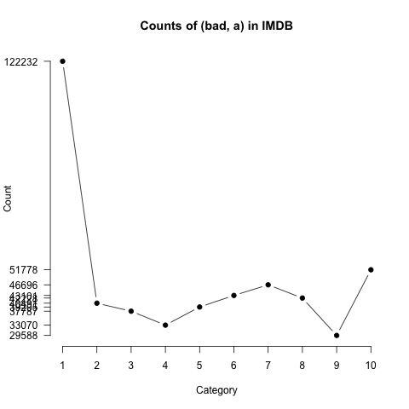
Learning polarity probabilities
Potts, Christopher. 2011. On the negativity of negation. SALT 20, 636-659.
How likely is each word to appear in each sentiment class?
Count(“bad”) in 1-star, 2-star, 3-star, etc.
But can’t use raw counts:
Instead, likelihood:
Make them comparable between words
Scaled likelihood:
Notes:
Thanks to Chris Potts for permission to use figure

Slide 28
Polarity in IMDB
Potts, Christopher. 2011. On the negativity of negation. SALT 20, 636-659.
Scaled likelihood
P(w|c)/P(w)
Scaled likelihood
P(w|c)/P(w)
Notes:
Thanks to Chris Potts for permission to use figures

Slide 29
Other sentiment feature: Logical negation
Potts, Christopher. 2011. On the negativity of negation. SALT 20, 636-659.
Is logical negation (no, not) associated with negative sentiment?
Potts experiment:
Count negation (not, n’t, no, never) in online reviews
Regress against the review rating

Slide 30
Potts 2011 Results: More negation in negative sentiment
a
Scaled likelihood
P(w|c)/P(w)
Notes:
Thanks to Chris Potts for permission to use figures

Slide 31
Lexicon learning
Use a small amount of information
A few labeled examples
A few hand-built patterns
To bootstrap a lexicon

Slide 32
Conjunctive polarity transfer
Vasileios Hatzivassiloglou and Kathleen R. McKeown. 1997. Predicting the Semantic Orientation of Adjectives. ACL, 174–181
Adjectives conjoined by “and” have same polarity
Fair and legitimate, corrupt and brutal
*fair and brutal, *corrupt and legitimate
Adjectives conjoined by “but” do not
fair but brutal

Slide 33
Annotation
Label seed set of 1336 adjectives (all >20 in 21 million word WSJ corpus)
657 positive
adequate central clever famous intelligent remarkable reputed sensitive slender thriving…
679 negative
contagious drunken ignorant lanky listless primitive strident troublesome unresolved unsuspecting…

Slide 34
Identification
Expand seed set to conjoined adjectives
nice, helpful
nice, classy

Slide 35
Transfer
Supervised classifier assigns “polarity similarity” to each word pair, resulting in graph:
brutal
helpful
corrupt
irrational
nice
fair
classy

Slide 36
Partitioning
Clustering for partitioning the graph into two
+
-
brutal
helpful
corrupt
irrational
nice
fair
classy

Slide 37
Output polarity lexicon
Positive
bold decisive disturbing generous good honest important large mature patient peaceful positive proud sound stimulating straightforward strange talented vigorous witty…
Negative
ambiguous cautious cynical evasive harmful hypocritical inefficient insecure irrational irresponsible minor outspoken pleasant reckless risky selfish tedious unsupported vulnerable wasteful…

Slide 38
Output polarity lexicon
Positive
bold decisive disturbing generous good honest important large mature patient peaceful positive proud sound stimulating straightforward strange talented vigorous witty…
Negative
ambiguous cautious cynical evasive harmful hypocritical inefficient insecure irrational irresponsible minor outspoken pleasant reckless risky selfish tedious unsupported vulnerable wasteful…

Slide 39
Turney algorithm for phrase polarity
Turney (2002): Thumbs Up or Thumbs Down? Semantic Orientation Applied to Unsupervised Classification of Reviews
Extract a phrasal lexicon from reviews
Learn polarity of each phrase
Rate a review by the average polarity of its phrases

Slide 40
Extract two-word phrases with JJ
First Word | Second Word | Third Word (not extracted)
JJ | NN or NNS | anything
RB, RBR, RBS | JJ | Not NN nor NNS
JJ | JJ | Not NN or NNS
NN or NNS | JJ | Nor NN nor NNS
RB, RBR, or RBS | VB, VBD, VBN, VBG | anything

Slide 41
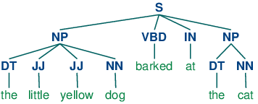
Depends on POS tagging
Assigning a grammatical category for each word in a document
One of the oldest linguistics projects
Nearly perfect accuracy in English now possible

Slide 42
How to measure polarity of a phrase?
Positive phrases co-occur more with “excellent”
Negative phrases co-occur more with “poor”
But how to measure co-occurrence?

Slide 43
Pointwise Mutual Information
Mutual information between 2 random variables X and Y
Pointwise mutual information:
How much more do events x and y co-occur than if they were independent?

Slide 44
How to Estimate Pointwise Mutual Information
Use a proximity query-enabled search engine
P(word) estimated by hits(word)/N
P(word₁,word₂) by hits(word1 NEAR word2)/N

Slide 45
Does phrase appear more with “poor” or “excellent”?

Slide 46
Phrases from a thumbs-up review
Phrase | POS tags | Polarity
online service | JJ NN | 2.8
online experience | JJ NN | 2.3
direct deposit | JJ NN | 1.3
local branch | JJ NN | 0.42
…
low fees | JJ NNS | 0.33
true service | JJ NN | -0.73
other bank | JJ NN | -0.85
inconveniently located | JJ NN | -1.5
Average |  | 0.32

Slide 47
Phrases from a thumbs-down review
Phrase | POS tags | Polarity
direct deposits | JJ NNS | 5.8
online web | JJ NN | 1.9
very handy | RB JJ | 1.4
…
virtual monopoly | JJ NN | -2.0
lesser evil | RBR JJ | -2.3
other problems | JJ NNS | -2.8
low funds | JJ NNS | -6.8
unethical practices | JJ NNS | -8.5
Average |  | -1.2

Slide 48
Results of Turney algorithm
410 reviews from Epinions
170 (41%) negative
240 (59%) positive
Majority class baseline: 59%
Turney algorithm: 74%
Phrases rather than words
Learns domain-specific information

Slide 49
Using WordNet to learn polarity
S.M. Kim and E. Hovy. 2004. Determining the sentiment of opinions. COLING 2004
WordNet: online thesaurus indexing words by synonyms
Create positive (“good”) and negative seed-words (“terrible”)
Find Synonyms and Antonyms
Positive Set: Add synonyms of positive words (“well”) and antonyms of negative words
Negative Set: Add synonyms of negative words (“awful”) and antonyms of positive words (”evil”)
Repeat, following chains of synonyms
Filter

Slide 50
Summary: Learning Lexicons
Advantages:
Can be domain-specific
Can be more robust (more words)
Intuition
Start with a seed set of words (‘good’, ‘poor’)
Find other words that have similar polarity:
Using “and” and “but”
Using words that occur nearby in the same document
Using WordNet synonyms and antonyms
Use seeds and semi-supervised learning to induce lexicons

Slide 51
Finding aspect/attribute/target of sentiment
Frequent phrases + rules
Find all highly frequent phrases across reviews (“fish tacos”)
Filter by rules like “occurs right after sentiment word”
“…great fish tacos” means fish tacos a likely aspect
Casino | casino, buffet, pool, resort, beds
Barber | haircut, job, experience, kids
Restaurant | food, wine, service, appetizer, lamb
Store | selection, department, sales, shop, clothing

Slide 52
Finding aspect/attribute/target of sentiment
The aspect name may not be in the sentence
For restaurants/hotels, aspects are well-understood
Supervised classification
Hand-label a small corpus of restaurant review sentences with aspect
food, décor, service, value, NONE
Train a classifier to assign an aspect to asentence
“Given this sentence, is the aspect food, décor, service, value, or NONE”

Slide 53
Reviews as mixtures of aspects
S. Blair-Goldensohn, K. Hannan, R. McDonald, T. Neylon, G. Reis, and J. Reynar. 2008. Building a Sentiment Summarizer for Local Service Reviews. WWW Workshop
Sentences
& Phrases
Sentences
& Phrases
Sentences
& Phrases
Final
Summary
Reviews
Text
Extractor
Sentiment
Classifier
Aspect
Extractor
Aggregator

Slide 54
Typical results
Rooms (3/5 stars, 41 comments)
(+) The room was clean and everything worked fine – even the water pressure ...
(+) We went because of the free room and was pleasantly pleased ...
(-) …the worst hotel I had ever stayed at ...
Service (3/5 stars, 31 comments)
(+) Upon checking out another couple was checking early due to a problem ...
(+) Every single hotel staff member treated us great and answered every ...
(-) The food is cold and the service gives new meaning to SLOW.
Dining (3/5 stars, 18 comments)
(+) our favorite place to stay in biloxi.the food is great also the service ...
(+) Offer of free buffet for joining the Play

Slide 55
Application summary
Sentiment analysis tries to identify positive or negative attitudes from documents
Applying this to social media gives you a real-time picture of how people are feeling, broadly speaking
Specializing to targeted content can make this a very useful technology for politics, finance, entertainment etc.
Sentiment analysis yet to take off in India
Vast open spaces for innovative (or even copycat) pioneers

